Slide 1
Online Auction
Prepared by
Dr. Risala Tasin Khan
Professor
IIT, JU

Slide 2
Some Key Words
Bid:
A price offer of the item on auction that an interested buyer is willing to pay is called a bid.
Bidding:
Bidding is an offer (often competitive) of setting a price one is willing to pay for something.
Bidder:
One who submits a response to an invitation for bid (IFB) is called a bidder. In an auction, goods or property are sold to the highest bidder (= the person who offers the most money for it).
Auctioneer:
An auctioneer is one who handles the whole auction process on behalf of a vendor (or seller). He/she keeps the auction going until the bids are closed. The auctioneer is bound by certain rules.

Slide 3
What is Auction
An auction is a process of buying and selling goods publicly by offering them up for bid, taking bids, and then selling the item to the winning bidder (highest bidder).
It is a powerful commerce instrument to settle price negotiation between buyers and sellers.
It is mainly used in the case where the price of a goods or service can not be prejudged.
In an auction, a seller offers a product or an item for sale. This is called “putting an item up for bid”, because the seller does not put a price on the item. Interested buyers get information about the item and offer bids- prices they are willing to pay. An auctioneer, who handles the whole process, keeps the auction going until the bids are closed.

Slide 4
Continue…
There are several variations on the basic auction form, including-
- time limits,
- minimum or maximum limits on bid prices
- special rules for determining the winning bidder(s) and sale price(s)
- participants in an auction may or may not know the identities or actions of other participants
- depending on the auction, bidders may participate in person or remotely through a variety of means, including telephone and the internet
- the seller usually pays a commission to the auctioneer or auction company based on a percentage of the final sale price.

Slide 5
What is an Online Auction
It is a convenient, efficient, and effective method of buying and selling merchandise over the Internet.
Online auction allows bidders to participate in many auctions at once or perhaps in many auctions in a short time span.
Online auctions break down and remove the physical limitations of traditional auctions such as geography, presence, time, space, and a small target audience.
Online auctions has also drawback. It is easier to commit unlawful actions within an auction.
eBay is the largest C2C online auction web site in the world which has over 42 million registered users and was the host of over $9.3 billion worth of goods sold in over 18,000 categories ranging from consumer electronics and collectibles to real estate and cars.

Slide 6
Key features of eBay auction
eBay auctions have a finite duration (3, 5, 7, or 10 days).
The data available to bidders during the duration of the auction include:
the items description,
the number of bids,
the bid of the current highest bidder,
the time remaining until the end of the auction,
whether or not the reserve price has been met,
the starting price of the auction, and
The auction ends when time has expired and the item goes to the highest bidder at a price equal to a small increment above the second highest bid.

Slide 7
Why Online Auction is Popular
No fixed time constraint
No geographical limitations
Includes a large numbers of sellers and bidders, which encourages a high volume online business

Slide 8
Various Types of Auctions
Auctions can be grouped into several categories based on some factors, such as:
the number of participants (i.e. whether m sellers offer an item that a buyer requests [supply or reverse auction], n buyers bid for an item being sold [demand auction], or n buyers bid to buy items from m sellers [double auction])
procedure for bidding or asking (i.e. whether prices are offered by buyers or asked by sellers in the auction. For example, in an open auction, participants may repeatedly bid and are aware of each other's previous bids. In a closed auction, buyers and/or sellers submit sealed bids)

Slide 9
Continue….
the price at which the item is sold (i.e. whether the first highest price (as in the case of English auction), the second highest price (as in the case of Vickrey auction).
dynamic nature of bid,
usage of auction in the market all over the world.

Slide 10
Some Popular Auction
Some popular types of auctions are listed below:
(i) English Auction
(ii) Dutch Auction
(iii) Double Auction
(iv) Bid Auction
(v) Clearing-house Auction
(vi) First-price Sealed-bid Auction
(vii) Second-price Sealed-bid Auction

Slide 11
English Auction
This type of auction is the most common form of auction used today.
In English auction (or, open ascending price auction), the auctioneer quickly pronounces a starting price (or, SOB= Suggested Opening Bid) for the item in auction and then sequentially increases the offer price by small increments until there is only one active bidder remains or there is no response to a price for a long time.
The auctioned item is sold to the bidder with the highest bid.
Alternatively, if the seller has set a minimum sale price in advance (the 'reserve' price) and the final bid does not reach that price, the item remains unsold.
The most significant and distinguishing factor of this auction type is that the current highest bid is always available to potential bidders.
Unlike sealed bid auction, English auction is "open" or fully transparent as the identity of all bidders is disclosed to each other bidder during the auction.
An English auction is particularly useful for goods with a currently unknown market value, such as art works, antiques, but also secondhand goods and real estate.
At least two bidders are required in this type of auction.

Slide 12
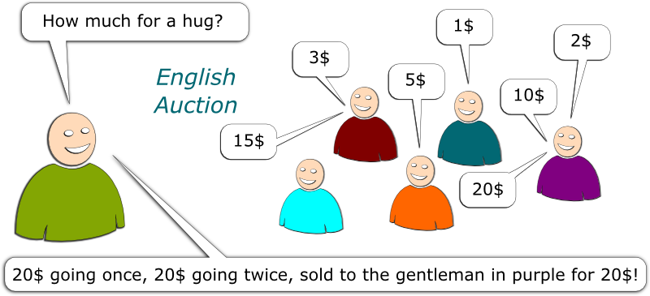

Slide 13
Advantage and Disadvantage of English Auction
Advantage:
The popularity of the English auction is due to the fact that it uses a mechanism that people find familiar and intuitive and therefore reduces transaction costs.
Online English auction also transcends the boundaries of a traditional English auction where physical presence is required by the bidders, making it increasingly popular even though there is a susceptibility to various forms of cheating.
An English auction also has the advantage of price discovery. This effect is particularly useful for goods with a currently unknown market value, such as works of art. Unlike the Dutch auction, the seller in an English auction does not limit the maximum possible bid ex-ante.

Slide 14
Advantage and Disadvantage of English Auction
Disadvantage:
Winner's curse is rampant in these auctions due to strong competition and inexperienced participants getting carried away in the heat of the moment. This auction is good for the seller. But, the object on sale can be bought for much less than its value if bidding is slow, and rings can take advantage of the nature of English auctions.
A disadvantage for both buyers and sellers with the English auction is that everyone must be in communication over the course of the auction, which can be expensive and difficult.

Slide 15
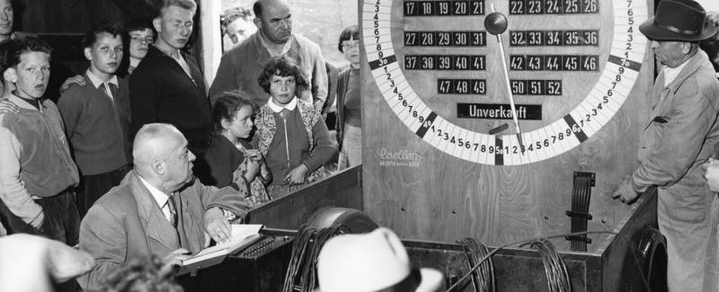
Dutch Auction
This auction is also known as clock auction or open descending price auction.
Dutch auctions are the reverse of English auctions whereby the auctioneer begins with a high asking price which is lowered sequentially until a buyer (or, participant) is willing to accept the auctioneer's price.
Traditionally, the prices are indicated on the dial of a clock. Instead of increasing, the clock-hand falls over a price. When the auction starts, the clock hand starts moving sequentially to a lower price value. The fall of price continues until a buyer presses a button to stop the clock. He who presses the button first, wins the auction at the current price.
In this type of auction, if a buyer really wants an item, he/she cannot afford to wait too long to enter his/her bid and is in pressure to press early. This means, the buyer might bid at or near his highest valuation and it normally goes in favors of the seller. Due to this nature of the Dutch auction, the sellers are normally at the advantage.

Slide 16
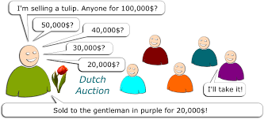

Slide 17
Dutch Auction Vs. English Auction
The problem with both English and Dutch auction is that the bidding participants must be present over the course of the auction, which can be expensive and difficult. This limits the domain of possible bidders.
English auction is incremental, whereas Dutch auction is decremental.
English auction is normally used to sell valuable arts, jewelry, whereas Dutch auction is used for perishable items such as flowers, fish, etc.

Slide 18
Japanese Auction
It is also called bid auction.
In this type of auction, all bids are offered by prospective buyers at the same time using individual hand signals for each monetary unit.
The main feature of the Japanese auction is that the bidders must bid at each level to remain in the running for the featured item. For example, if the starting bid on an item is $25, all interested bidders must bid $25. If the next bid is $30, and a bidder does not bid $30, the bidder cannot re-enter the bidding, even if s/he is willing to bid higher than $30.
The auction continues until only one bidder remains.
The winner is the bidder with the highest bid and all bidders are expected to register their maximum bid within the allotted time.
This form of bidding is extremely fast which is important in the fresh food markets of Japan when time lost means fish that cannot be sold.

Slide 19
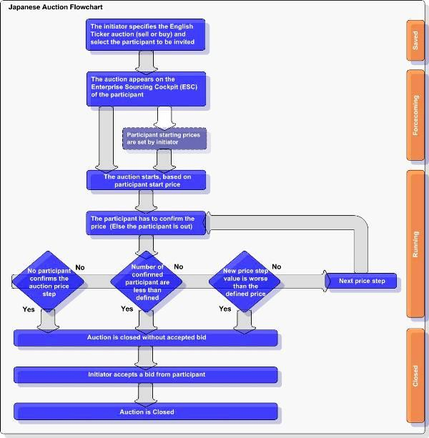

Slide 20
First-Price Sealed-Bid Auction (FPSB)
This auction is also known as sealed first-price auction.
In this type of auction, all bidders simultaneously submit sealed bids so that no bidder knows the bid of any other participant.
The single highest bidder wins and pays the winning bid, i.e., the price they submitted.
This type of auction is distinct from the English auction, in that bidders can only submit one bid each. Furthermore, as bidders cannot see the bids of other participants they cannot adjust their own bids accordingly.
Sealed first-price auctions are commonly used in tendering, particularly for government contracts and auctions for mining leases.

Slide 21
Second Price Sealed-Bid Auction (SPSB)
This auction is also known as Vickrey auction as it is introduced by Vickrey.
In this auction, bidders submit bids; the highest bidder wins and pays a price equal to the second highest bid (i.e. pay what the second highest bidder had bid).
Although extremely important in auction theory, in practice Vickrey auctions are rarely used.

Slide 22
How does it work
Vickrey auction is a type of auction where all the bidders will bid for their true value or worth and will have the maximum willingness to pay for the highest price to stand as the winner of the bid.
The auction is a sealed bid where no bidder is aware of other bids.
Thus everyone contributes willingly and wants to go the extra mile to win the bid.
In a simple way, every bidder will put the maximum bid possible. They are kind of motivated or encouraged to quote a high bid because anyways, they won’t be paying the highest amount and will only have to pay for the second-highest bid.
This will not cause any disadvantage to the bidder for quoting the maximum bid.
Thus, we see Vickrey auction follows the second price mechanism.
By following the second price mechanism, bidders will bid truthfully.

Slide 23
Example
Suppose an online bid for the auction of painting is going live. A bidder places a bid of $5000 for it.
Now when a bidder places that amount, he won’t place a bid more than $5000 because that is the maximum worth according to him for the painting, and he will also not place a higher bid on account of the fact that he might actually have to end upon paying the price higher than his willingness.
On the other hand, the bidder will also not place a price lesser than $5000 because he might be of the belief that he might lose the bid if he places a lower bid than what he was actually willing to.
Thus we find in Vickrey auction the buyer’s willing places a true bid for the item and is motivated to do so to win the bid.

Slide 24
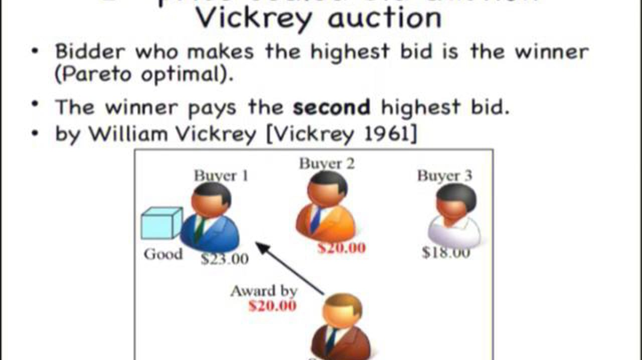

Slide 25
Reserve Auction
This is an auction where the item for sale may not be sold if the final bid is not high enough to satisfy the seller - that is, the seller reserves the right to accept or reject the highest bid. In these cases a 'reserve' price may have been set in advance below which the item may not be sold which is known to the auctioneer, but not necessarily to the bidders.

Slide 26
How it works?
In case any items are to be sold by way of the auction, then the seller can ask for keeping the minimum price at which he can sell the item known as the reserve price (excluding the cases of no reserve auction).
Now the auction firm, on request of the seller, will keep the reserve price of the item.
This will generally be the hidden price except for the cases when the seller is ready to disclose the same to the potential buyers.
Now during the process of bidding, if the highest bidding exceeds the reserve price, then the auction will get complete, and the deal will be executed between the seller and the highest bidder.
In this case, the seller is bound to complete the deal. However, in case if the highest bidding does not exceed the reserve price, then the seller is bound to complete the deal, and if the seller does not accept the deal, then it will not be executed.

Slide 27
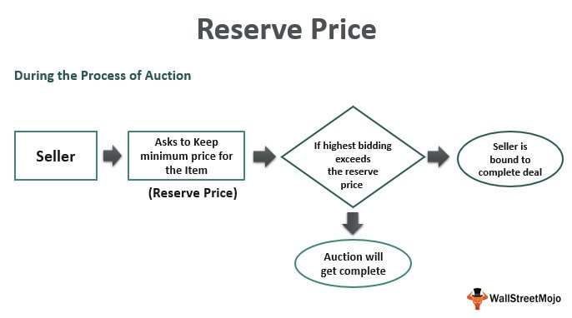

Slide 28
No-Reserve (NR) Auction
No-reserve auction, also known as an absolute auction, is an auction in which the item for sale will be sold regardless of price. From the seller's perspective, advertising an auction as having no reserve price can be desirable because it potentially attracts a greater number of bidders due to the possibility of a bargain.
If more bidders attend the auction a higher price might ultimately be achieved because of heightened competition from bidders. This contrasts with a reserve auction, where the item for sale may not be sold if the final bid is not high enough to satisfy the seller.

Slide 29
Reverse Auction
It is a type of auction in which the role of the buyer and seller are reversed, with the primary objective to drive purchase prices downward.
In an ordinary auction (also known as forward auction), buyers compete to obtain a good or service. But in a reverse auction, multiple sellers compete to provide a good or service by offering progressively lower quotes until no supplier is willing to make a lower bid.
They do not follow the typical auction format in that the buyer can see all the offers and may choose which they would prefer.

Slide 30
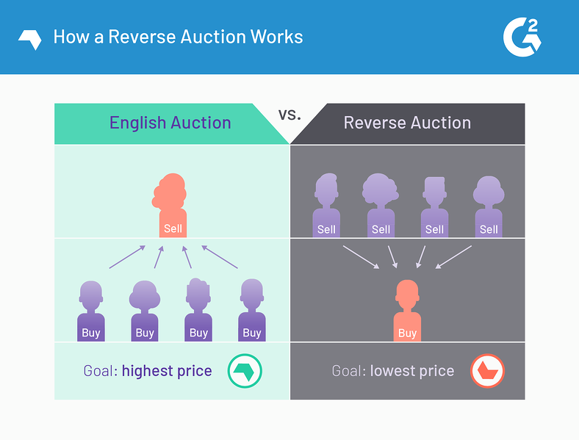

Slide 31
Silent Auction
Silent auction is a variant of an English auction where bids are written on a sheet of paper. At the predetermined end of the auction the highest listed bidder wins the item.
The auction is "silent" in that there is no auctioneer, the bidders writing their bids on a bidding sheet often left on a table near the item. Other variations of this type of auction may include sealed bids. The highest bidder pays the price he or she submitted.
This auction is often used in charity events, with many items auctioned simultaneously with a common finish time.

Slide 32
Problems of Auction
Fraud:
The increasing popularity of using online auctions has led to an increase in fraudulent activity. This is usually performed on an auction website by creating a very appetizing auction, such as a low starting amount. Once a buyer wins an auction and pays for it, the fraudulent seller will either not pursue with the delivery, or send a less valuable version of the purchased item (replicated, used, refurbished, etc.).
Protection to prevent such acts has become readily available, most notably Paypal's buyer protection policy. As Paypal handles the transaction, they have the ability to hold funds until a conclusion is drawn whereby the victim can be compensated.

Slide 33
Problems of Auction (Cont..)
Winner’s Curse:
It is a financial theory that the winning participants within an auction will typically pay an overvalued price for the winning item. In short, the winner's curse says that in an auction, the winner will tend to overpay. However, an actual overpayment will generally occur only if the winner fails to account for the winner's curse when bidding. So despite its dire-sounding name, the winner's curse does not necessarily have ill effects.
The severity of the winner's curse increases with the number of bidders. This is because the more bidders, the more likely it is that some of them have overestimated the auctioned item's value

Slide 34
Problems of Auction (Cont..)
Sale of Stolen Goods:
Online auction websites are used by thieves or fences to sell stolen goods to unsuspecting buyers. According to police statistics there were over 8000 crimes involving stolen goods, fraud or deception reported on eBay in 2009. It has become common practice for organized criminals to steal in-demand items, often in bulk. These items are then sold online as it is a safer option due to the anonymity and worldwide market it provides. Auction fraud makes up a large percentage of complaints received by the FBI’s Internet Crime Complaint Center (IC3). This was around 45% in 2006 and 63% in 2005.

Slide 35
Problems of Auction (Cont..)
Collusion:
Whenever bidders at an auction are aware of the identity of the other bidders there is a risk that they will form a “Ring” and thus manipulate the auction result. By agreeing to bid only against outsiders, never against members of the “Ring”, competition becomes weaker, which may dramatically affect the final price level. After the end of the official auction, an unofficial auction will take place among the “Ring” members. The difference in price between the two auctions will then be split among the “Ring” members.

Slide 36

How Online Auction Works
To Sell an Item Online:
The user opens the auction web site in a browser.
The user selects a category of auction items, which sends a request to the Web server and returns a page.
To sell an item, the user selects "sell" from the navigation bar. This opens the sale form.
The user then enters the values for the item for sale, such as value, description, and length of auction.
The user submits the form and the data is transmitted to the database.
The page reopens displaying the name of the item the user registered in the auction.

Slide 37
Continue…
To Bid an Item Online:
The user opens the auction web site in a browser.
To bid on an item, the user selects the desired item and opens a bid form.
The user can either bid by the next increment amount, or enter a maximum bid, allowing the auction site to bid on the user's behalf.
The user clicks Submit and registers the bid in the auction.
The Web server refreshes the page and displays the new bid.
When the time has expired, a Web service processes the winning bidder's credit card information.

Slide 38
General Components of an Online Auction
The online auction needs secured auction sites to performed secured auction related transactions. The first step of doing online auction is to setup auction rules to perform the auction. Components of an online auction are described below:
1. Registration of buyers and bidders using secure transaction
For identifying trading parties, registration must be accomplished. Some secret keys such as passwords are exchanged during this session. In some auction sites, a profile of each trader is created to reflect his/her interest in products or services of different kinds.
2. Search facilities for interested auction items in the site
Search facilities allow conducting the search of interested auction items. Some auction sites give a full description of the item, minimum auction requirements, starting price, reserve price if any, probably sample photos along with the auction rules.

Slide 39
General Components of Online Auction (Continue..)
3. Bid placement and processing
This step handles the collection of bids from the buyers and implements the bid control rules of the auction e.g. minimum bid, bid increment and deposits required with bids.
4. Auction duration
This step specifies how long the bidder may participate in the auction process and when it will be finished.
5. Winner declaration and deal processing (payment method)
This step implements the auction closing rules and notifies the winners and losers of the auction. Some auction sites notify the winner through e-mail and others post an highest bidder on the auction web page.

Slide 40
Continue..
6. Transfer of auction item and collection of bid
This step handles the payment to the seller, the transfer of goods to the buyer, and if the seller is not the auctioneer, payment of fees to the auctioneer and other agents.
The online auction sites also posses some bidding policies along with privacy policy.

Slide 41

FLOWCHART OF ONINE AUCTION

Slide 42
